Slide 1
Artificial Intelligence Introduction
Dr. Kavita S. Oza

Slide 2
Introduction
AI is the study of how to make computers perform tasks that humans consider difficult through the creation of intelligent agents.
The intelligence demonstrated by machines is known as Artificial Intelligence.
The study of AI began in the 1950s, and it has improved dramatically over time with better statistical methods and greater computing power.
The term Artificial Intelligence was coined by John McCarthy. He is considered as the father of AI.

Slide 3
Human-likeness of an AI entity
Systems that think like humans | Systems that think rationally
Systems that act like humans | Systems that act rationally

Slide 4
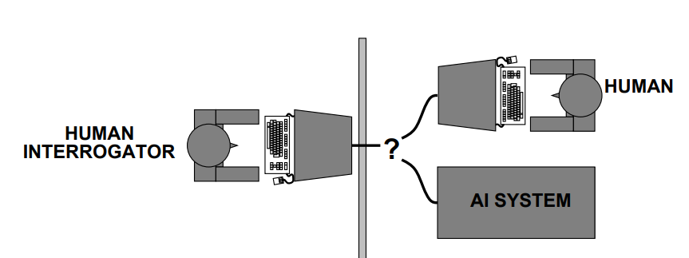
Acting humanly: The Turing test
Turing (1950) “Computing machinery and intelligence”
“Can machines think?” −→ “Can machines behave intelligently?”
Operational test for intelligent behavior: the Imitation Game
British mathematician and computer pioneer Alan Turing, who helped break crucial secret codes, particularly those sent on Germany's Enigma machine during World War II.
Suggested major components of AI:
knowledge, reasoning,
language understanding,
learning
Turing test is not
reproducible,
constructive, or
amenable to
mathematical analysis

Slide 5
Thinking humanly: Cognitive Science
Requires scientific theories of internal activities of the brain
As the name suggests, this approach tries to build an Artificial Intelligence model based on Human Cognition.
Introspection: observing human thoughts, and building a model based on that
Psychological Experiments: conducting experiments on humans and observing their behavior
Brain Imaging: Using MRI to observe how the brain functions in different scenarios and replicating that through code.

Slide 6
Thinking rationally: Laws of Thought
Normative (or prescriptive) rather than descriptive
A prescriptive statement suggests a course of action.
The Laws of Thought are a large list of logical statements that govern the operation of our mind.
The same laws can be codified and applied to artificial intelligence algorithms.
Problems:
1) Not all intelligent behavior is mediated by logical deliberation
2) What is the purpose of thinking? What thoughts should I have out of all the thoughts (logical or otherwise) that I could have

Slide 7
Acting rationally
A rational agent acts to achieve the best possible outcome in its present circumstances.
According to the Laws of Thought approach, an entity must behave according to the logical statements.
But there are some instances, where there is no logical right thing to do, with multiple outcomes involving different outcomes and corresponding compromises.
The rational agent approach tries to make the best possible choice in the current circumstances.
The right thing: that which is expected to maximize goal achievement, given the available information

Slide 8
Goals of Artificial Intelligence
It helps reduce the amount of time needed to perform specific tasks.
Making it easier for humans to interact with machines.
Facilitating human-computer interaction in a way that is more natural and efficient.
Improving the accuracy and speed of medical diagnoses.
Helping people learn new information more quickly.

Slide 9
Modeling – Algorithm – Application – Theory

Slide 10
Types of AI
AI
Ability based
Narrow AI
Functionality based
Reactive Machines
General AI
Super AI
Limited Memory
Theory of Mind
Self-Awareness

Slide 11
Narrow AI: Machine Learning
Narrow AI is also called weak AI.
Can only work in predefined situations.
Can only perform certain pre-programmed tasks.
Have narrow capabilities, like recommending a product for an e-commerce user or predicting the weather.
Siri, Alexa, Cortana

Slide 12
General AI : Machine Intelligence
Can perform any task with efficiency equal to that of a human.
It is still a theoretical concept.
AI which has a human-level of cognitive function, across a wide variety of domains such as language processing, image processing, computational functioning and reasoning and so on.
System would need to comprise of thousands of Artificial Narrow Intelligence systems working in tandem, communicating with each other to mimic human reasoning.

Slide 13
Super AI : Machine consciousness
Is a hypothetical concept in AI research.
An Intellect that is much smarter than the best human brains in practically every field
Science-fiction
System would be able to surpass all human capabilities.
decision making, taking rational decisions, and even includes things like making better art and building emotional relationships.

Slide 14
Classification based on functionality
Reactive Machines AI
Limited Memory AI
Theory Of Mind AI
Self-aware AI

Slide 15
Reactive Machines
This type of AI looks at the world around it and responds based on its observation.
Reactive AI machines cannot form inferences from the data to evaluate their future actions.
They do not form memory nor do they learn from past experiences.
They can perform a narrowed range of pre-defined tasks.
IBM’s chess-playing supercomputer, Deep Blue

Slide 16
Limited Memory
AI has a short-lived or a temporary memory that can be used to store past experiences and hence evaluate future actions.
Limited memory AI is similar to reactive machines except they have a small memory that they can use to make observations over a period of time to judge the situation and give a response based on that.
self-driving cars.
Self-driving cars need at least short term memory to react properly to road signs and to observe the speeds and paths of other vehicles around them.

Slide 17
Theory of Mind
This type of AI does not exist yet.
AI will focus mainly on emotional intelligence so that human believes and thoughts can be better comprehended.
They understand how other objects and entities will react to their actions and act accordingly.

Slide 18
Self-Awareness
Self-aware AI is an AI with an idea of self.
This type of AI has consciousness and sentiments as well.
Currently, this type of AI is purely hypothetical.
Let’s just pray that we don’t reach the state of AI, where machines have their own consciousness and become self-aware.

Slide 19
Sub-domains of Artificial Intelligence
Machine Learning
Deep learning
Natural Language processing
Computer Vision
Neural Networks

Slide 20
Machine Learning
ML teaches a machine how to make inferences and decisions based on past experience.
It identifies patterns and analyses past data to infer the meaning of these data points to reach a possible conclusion without having to involve human experience.
This automation to reach conclusions by evaluating data saves human time for businesses and helps them make a better decisions.

Slide 21
Neural Networks
Work on similar principles to Human Neural cells.
They are a series of algorithms that captures the relationship between various underlying variables and processes the data as a human brain does.

Slide 22
Deep Learning
Deep Learning is an ML technique.
It teaches a machine to process inputs through layers in order to classify, infer and predict the outcome.

Slide 23
Natural Language Processing
NLP is a science of reading, understanding, and interpreting a language by a machine.
Once a machine understands what the user intends to communicate, it responds accordingly.

Slide 24
Computer Vision
Computer vision algorithms try to understand an image by breaking down an image and studying different parts of the object.
This helps the machine classify and learn from a set of images, to make a better output decision based on previous observations.

Slide 25
AI in Everyday life
Online shopping
Digital Personal Assistants
Cyber security
AI against Covid-19
Machine translations

Slide 26
AI in Healthcare
Administration
Telemedicine
Assisted Diagnosis
Robot Assisted Surgery
Monitor of vital stats
Virtual Nurse Assistance
Error reductions
Fraud detections
Research and study
Chronic care management

Slide 27
Examples of Artificial Intelligence
Facebook Friends Recommendations
Siri, Alexa and other smart assistants
Self-driving cars
Robo-advisors
Conversational bots
Email spam filters
Netflix’s recommendations
Proactive healthcare management
Disease mapping
Automated financial investing
Virtual travel booking agent
Social media monitoring

Slide 28
Advantages
Reduces human error
Lessening repetitive work
Digital assistance
Faster and more accurate decisions

Slide 29
Disadvantages
Potential of misuse
A lack of creativity
AI cannot generate fundamentally new ideas on its own
The absence of empathy
AI can be taught to recognize human emotions such as frustration, but a machine cannot empathize and has no ability to feel
Skill loss in humans
people could lose their ability to know and understand how to perform skilled tasks.
Possible overreliance on the technology and increased laziness in humans
Job loss and displacement
many jobs will be eliminated due to some degree of automation by AI

Slide 30
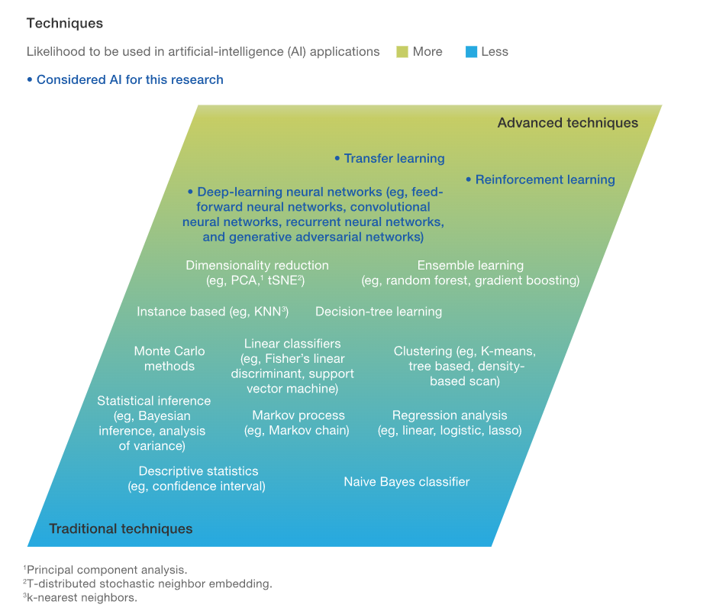

Slide 31

Current AI

Slide 32
Thank you

